Slide 1






AGENCIES RESPONSIBLE FOR INTELLECTUAL PROPERTY REGISTRATION

Slide 2


Slide 3
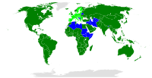

TRADE-RELATED ASPECTS OF INTELLECTUAL PROPERTY RIGHTS (TRIPS)
The Agreement on Trade-Related Aspects of Intellectual Property Rights (TRIPS) is an international agreement administered by the World Trade Organization (WTO) that sets down minimum standards for many forms of intellectual property (IP) regulation as applied to nationals of other WTO Members.

Slide 4
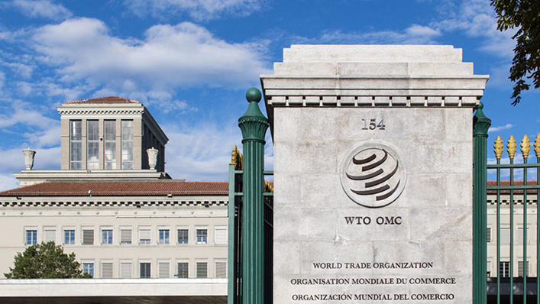
The agreement covers five broad issues
How basic principles of the trading system and other international intellectual property agreements should be applied
How to give adequate protection to intellectual property rights
How countries should enforce those rights adequately in their own territories
How to settle disputes on intellectual property between members of the WTO
Special transitional arrangements during the period when the new system is being introduced.

Slide 5
The three main features of the Agreement
Standards: In respect of each of the main areas of intellectual property covered by the TRIPS Agreement, the Agreement sets out the minimum standards of protection to be provided by each Member.
Enforcement: The second main set of provisions deals with domestic procedures and remedies for the enforcement of intellectual property rights. The Agreement lays down certain general principles applicable to all IPR enforcement procedures.
Dispute settlement: The Agreement makes disputes between WTO Members about the respect of the TRIPS obligations subject to the WTO's dispute settlement procedures.

Slide 6
AGENCIES RESPONSIBLE FOR INTELLECTUAL PROPERTY REGISTRATION
World intellectual property organization (WIPO)-1967
International trade mark association (INTA)- 1878
Paris convention -1883
Berne Convention -1886
Madrid protocol – 1891,1989
North American Free Trade Agreements (NAFTA)- 1878
General Agreement on Tariffs and Trade (GATT)- 1947

Slide 7

World Intellectual Property Organization
Brief History of WIPO
Paris Union 1883
Berne Union 1886
International Bureau combined 1893
WIPO Convention 1967
UN Specialized Agency 1974
193 Membered nations

Slide 8

WIPO Mission
To promote the protection of IP rights worldwide and extend the benefits of the international IP system to all member States.

Slide 9

WIPO Objectives
The objectives of the system are two-fold. Firstly, it facilitates the obtaining of protection for marks (trademarks and service marks).
Secondly, since an international registration is equivalent to a bundle of national registrations, the subsequent management of that protection is made much easier.

Slide 10
WIPO
WIPO is the global forum for IP services, policy, information and cooperation.
The head quarter is located in Geneva, Switzerland.
It is a self-funding agency of the UN, with 193 member states.
The mission is to lead the development of a balanced and effective international intellectual property (IP) system that enables innovation and creativity for the benefit of all.
It is mandate, governing bodies and procedures are set out in the WIPO Convention, which established WIPO in 1967.

Slide 11

International Trade Mark Association (INTA)
INTA, originally known as the United States Trademark Association (USTA), was established in November 1878 in New York City by 17 merchants and manufacturers to protect and promote the rights of trademark owners, secure useful legislation, and give aid and encouragement to all efforts for the advancement.

Slide 12
International Trade Mark Association (INTA)
The International Trademark Association (INTA) is a world wide not-for profit association of trademark owners and professionals dedicated to supporting trademarks and IP in order to protect consumers and to promote fair and effective global commerce. INTA’s members are more than 6,500 organizations from 190 countries.

Slide 13

Berne Convention
The Berne Convention for the Protection of Literary and Artistic Works, usually known as the Berne Convention, is an international agreement governing copyright, which was first accepted in Berne Switzerland, in 1886.
The Berne Convention formally mandated several aspects of modern copyright law; it introduced the concept that a copyright exists the moment a work is "fixed", rather than requiring registration. It also enforces a requirement that countries recognize copyrights held by the citizens of all other signatory countries.

Slide 14

Madrid protocol
The Madrid system (officially the Madrid system for the international registration of marks) is the primary international system for facilitating the registration of trademarks in multiple jurisdictions around the world.
Its legal basis is the multilateral treaty Madrid Agreement Concerning the International Registration of Marks of 1891, as well as the Protocol Relating to the Madrid Agreement (1989).

Slide 15
Madrid system
The Madrid system provides a centrally administered system of obtaining a bundle of trademark registrations in separate jurisdictions.
Madrid provides a mechanism for obtaining trademark protection in many countries around the world which is more effective than seeking protection separately in each individual country or jurisdiction of interest.

Slide 16

Paris convention
The Paris Convention for the Protection of Industrial Property, signed in Paris, France, on 20 March 1883, was one of the first intellectual property treaties. It established a Union for the protection of industrial property. The Convention is currently still in force. The substantive provisions of the Convention fall into three main categories:
National treatment
Priority right
Common rules

Slide 17
North American Free Trade
Agreements (NAFTA)
The North American Free Trade Agreement was an agreement signed by Canada, Mexico, and the United States that created a trilateral trade bloc in North America. The agreement came into force on January 1, 1994, and superseded the 1988 Canada–United States Free Trade Agreement between the United States and Canada.
The North American Free Trade Agreement (NAFTA) is an agreement signed by Canada, Mexico, and the United States, creating a trilateral rules-based trade bloc in North America.

Slide 18
General Agreement on Tariffs and Trade (GATT)
General Agreement on Tariffs and Trade (GATT) was a multilateral agreement regulating international trade. According to its preamble, its purpose was the "substantial reduction of tariffs and other trade barriers and the elimination of preferences, on a reciprocal and mutually advantageous basis.“ It is responsible for trademark of IP.

Slide 19

General Agreement on Tariffs and Trade (GATT)
It was negotiated during the UN Conference on Trade and Employment and was the outcome of the failure of negotiating governments to create the International Trade Organisation (ITO).
GATT was signed by 23 nations in Geneva on October 30, 1947 and took effect on January 1, 1948.
It lasted until the signature by 123 nations in Marrakesh on April 14, 1994 of the Uruguay Round Agreements, which established the World Trade Organisation (WTO) on January 1, 1995.

Slide 20
Agencies Responsible for IP Registration
IP mechanism | Duration of Protection | Jurisdiction | Fee (Rs.) | Authority/Agency concerned
1. Patents | 20 years | National | 1000/- individual, 4,000/- Commercial entity | Controller of Patents, India with branches at New Delhi, Chennai, Mumbai and Kolkata.
2. Copyright | During life time of author and 60 years after his death | Global | 50/- for literary, artistic, musical, dramatic work. | Registrar of Copyright, New Delhi.
3. Trade marks | Initial protection is 10 years. But can be renewed indefinitely. | National | 3,500/- for each class | Registrar of Trademarks, India with branches at New Delhi, Chennai, Mumbai and Kolkata.
4. Industrial designs | Initial 10 years. Renewable for 5 years more i.e. total 15 years maximum. | National | 1000/- | Controller of Designs with branches at New Delhi, Chennai, Mumbai and Kolkata.
5. Layout designs of Integrated Circuits | 10 years | National | 5,000/- | Registrar, Semiconductor Integrated Circuits Layout Design Registry (SICLDR), New Delhi.
6. Plant varieties | 15 years for annual crops, 18 years for trees and vines | National | 5,000/- individual, 7,000/- educational, 10,000/- commercial. | Registrar of Plant varieties, New Delhi.
7. Geographical Indications | One time registration valid for 10 years. Can be renewed indefinitely. | National | 5,000/- for each class. | IP Indian offices at New Delhi, Chennai, Mumbai and Kolkata.
8. Trade secrets | No registration needed. Validity as per terms of agreement. | National | No fee | Civil courts of respected jurisdiction.

Slide 21
THANK YOU

